Slide 1
HealthVision AI
AI-Based Visual Health Screening
Final Year Project Presentation
AI-Based Visual
Health Screening System
A comprehensive AI-powered platform for non-invasive detection of Jaundice, Skin Diseases, and Nail Disorders using deep learning
Institution
Project Supervisor
Semester
Government Engineering College, Munger
Dr. Saurabh Suman
7th Semester
Department of Computer Science & Engineering (AI)
Assistant Professor, CSE Department
B.Tech CSE (Artificial Intelligence)
Project Team Members
G
Gaurav Kumar
N
Nitesh Kumar
R
Rupesh Kumar
I
Indrajeet Kumar
23151144901
22151144040
22151144010
23151144906

Slide 2
Project Overview
A comprehensive AI-based health screening platform for non-invasive disease detection
Key Statistics
Our Mission
Detection Modules
3
Build a non-invasive, AI-powered health screening platform that uses deep learning to analyze images of eyes, face skin, and nails to detect potential health conditions — without blood tests or lab visits .
24+
Detectable Conditions
Analysis Time
<2s
Input Resolution
224×224
CNN Architectures
2
Eye Detection
Face Detection
Nail Detection
Jaundice screening through sclera analysis
5-class skin disease classification
17+ nail disorder identification
Powered by MobileNetV2 & EfficientNet Transfer Learning

Slide 3
Why This Project?
Addressing critical gaps in accessible health screening
Limited Rural Access
Invasive Tests Required
Access to dermatological and ophthalmological screening is severely limited in rural and underserved areas. Many patients must travel long distances just for basic health assessments, creating barriers to early detection.
Jaundice detection traditionally requires blood tests to measure bilirubin levels. Our system enables non-invasive screening through simple sclera image analysis — no needles, no lab visits needed.
Rural healthcare gap affects millions
Non-invasive alternative available
Specialist Shortage
Early Detection Gap
Common skin conditions like Acne, Eczema, Herpes, and Rosacea require dermatological expertise. AI can assist in preliminary classification where specialists aren't available, bridging the expertise gap.
Nail abnormalities can indicate systemic health issues like liver disease, anemia, and autoimmune conditions. Early detection through image analysis prompts timely medical consultation, potentially saving lives.
AI bridges expertise gap
Early detection saves lives

Slide 4
Project Objectives
The key goals we set out to achieve with HealthVision AI
Core Objectives
Key Deliverables
1
Develop a multi-module AI platform capable of analyzing eye, face, and nail images for disease detection
Three Trained Models
.h5 format for eye, face, and nail detection
2
Implement transfer learning using MobileNetV2 and EfficientNetB0 for high-accuracy classification
Flask REST API Backend
3
Build an intelligent eye detection pipeline using OpenCV Haar cascades with dual-strategy detection
Prediction endpoints for each module
Create a responsive web interface supporting both image upload and real-time camera capture
Responsive Web Application
4
Camera and upload support with SPA design
5
Ensure privacy by processing all data locally — no images stored or transmitted to third-party services
Disease Information Database
Comprehensive info on 20+ conditions
6
Provide detailed disease information alongside predictions for educational and screening purposes
Image Enhancement Pipeline
Denoising and contrast normalization
Complete Documentation
Project report and deployment instructions

Slide 5
How It Works
A four-step pipeline from image capture to clinical prediction
1
2
3
4
Capture or Upload
Region Detection
AI Analysis
Get Results
Use your device camera with ROI guide overlay or upload a photo of the eye, face, or nail for analysis.
OpenCV Haar cascades locate the region of interest (eye sclera, face, nail) with intelligent fallback strategies.
Detected region is preprocessed (224×224, normalized) and fed to the appropriate deep learning model for inference.
Receive instant diagnosis: prediction label, confidence percentage, top-k classes, and detected region preview.
WebRTC camera support
Dual-strategy detection
< 2 seconds processing
Detailed disease info
Processing Speed
Privacy
Accuracy
Device Support
< 2 Seconds
100% Local
Up to 90.62%
All Devices

Slide 6
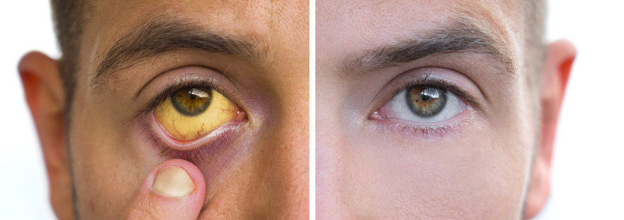
Detection Module 1: Eye / Jaundice Detection
Binary classification for jaundice screening through sclera analysis
Technical Specifications
About Jaundice
Architecture
Activation
MobileNetV2
Binary Sigmoid
Jaundice is caused by elevated bilirubin levels, which turn the sclera (white of the eye) yellow . Our model analyzes eye images to detect this discoloration for early screening.
Detection
Input Size
Non-invasive detection method
Haar Cascade
224×224
No blood tests required
Early warning system
Model Parameters
~2.4 Million Parameters
Detection Pipeline
Upload Image
Eye Detection
Sclera Crop
AI Analysis
Result

Slide 7
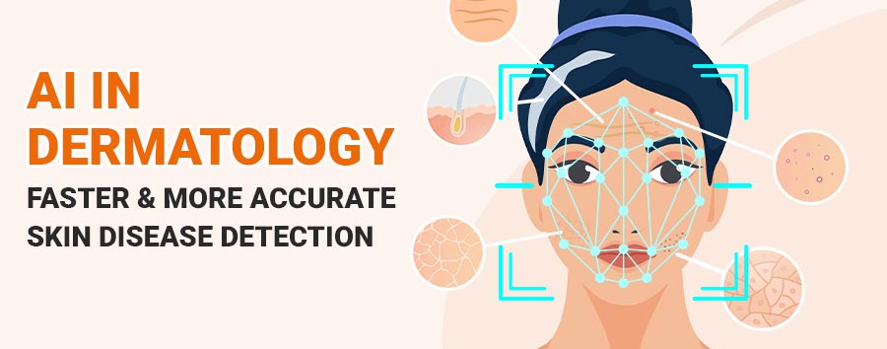
Detection Module 2: Face / Skin Disease Detection
5-class classifier for facial skin conditions using EfficientNetB0
5 Skin Conditions Detected
Acne
Eczema
Herpes
Panu
Rosacea
Mild
Moderate
Moderate
Mild
Moderate
Model Performance
Technical Specifications
Validation Accuracy
72.15%
Architecture
Classification
Training Images: 1,196
EfficientNetB0
5-Class Softmax
Validation Images: 298
ImageNet pre-trained
Multi-class output
Loss Function: Categorical Cross-Entropy
Normalization
Dense Layers
BatchNorm
256 + Dropout 0.5
Stabilized training
Regularization

Slide 8
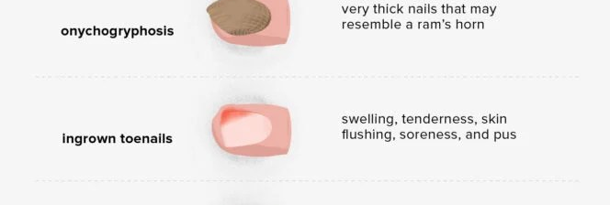
Detection Module 3: Nail Disease Detection
3-class nail disorder classifier for early health indicator detection
Why Nail Analysis?
3 Main Classes Detected
Nail abnormalities can indicate systemic health issues including liver disease, anemia, fungal infections, and autoimmune conditions. Early detection through image analysis enables timely medical consultation.
Healthy
Onychomycosis
Psoriasis
17+ detectable conditions
Normal nail condition
Fungal infection
Autoimmune condition
Systemic health indicators
Non-invasive screening
Technical Specifications
Architecture
Classification
MobileNetV2
3-Class Softmax
Input Size
Accuracy
224×224 pixels
85.71%
Training: 933 images | Validation: 231 images

Slide 9
Technology Stack
Built with industry-standard tools and frameworks
Deep Learning
Web Backend
TensorFlow / Keras
Python 3.10+
Primary ML framework
Programming language
MobileNetV2
Flask
Lightweight CNN architecture
Web framework
EfficientNetB0
Flask-CORS
High-efficiency model
Cross-origin support
ImageNet Transfer Learning
REST API / JSON
Pre-trained weights
Data exchange format
Computer Vision
Frontend
OpenCV
Haar Cascades
HTML5
CSS3
Image processing
Object detection
Structure
Styling
Pillow (PIL)
NumPy
JavaScript ES6+
WebRTC
Image manipulation
Numerical computing
Interactivity
Camera access

Slide 10
Training Datasets
Curated medical image datasets for each detection module
Jaundice Eye
Face Skin Disease
Nail Disease
ezyZip Dataset
FaceZip Dataset
nailZip Dataset
Classes
2
Classes
5
Classes
3
Jaundice, Normal
Acne, Eczema, Herpes, Panu, Rosacea
Healthy, Onychomycosis, Psoriasis
Training Images
136
Training Images
1,196
Training Images
933
Validation Images
32
Validation Images
298
Validation Images
231
Preprocessing
Preprocessing
Preprocessing
Rescale to [0, 1] (÷ 255)
EfficientNet preprocess_input
Rescale to [0, 1] (÷ 255)
Split: 80% Train / 20% Val
Split: 80% Train / 20% Val
Split: 80% Train / 20% Val
Data Augmentation (Training)
Rotation
Shift
Zoom
Flip
Brightness
Shear
Fill Mode
20°
15%
20%
Horizontal
0.7-1.3
10%
Nearest

Slide 11
Training Results & Accuracy
Two-stage training strategy with comprehensive performance metrics
Jaundice Model
Face Model
Nail Model
MobileNetV2
EfficientNetB0
MobileNetV2
Validation Accuracy
Validation Accuracy
Validation Accuracy
90.62%
72.15%
85.71%
Loss Function
Loss Function
Loss Function
Binary Cross-Entropy
Categorical Cross-Entropy
Categorical Cross-Entropy
Train
Val
Train
Val
Train
Val
136
32
1,196
298
933
231
Two-Stage Training Strategy
Training Callbacks
1
Stage 1: Feature Extraction
EarlyStopping
Base frozen, LR: 1e-3, 15 epochs
Patience: 5 epochs
2
Stage 2: Fine-Tuning
ReduceLROnPlateau
Top layers unfrozen, LR: 1e-5, 25 epochs
Patience: 3, Factor: 0.3
ModelCheckpoint
Save best only

Slide 12
Application Flowchart
Camera Capture
End-to-end data flow from user input to AI prediction output
| Image Upload
Image Preprocessing
Decode → RGB → Resize 224×224 → Normalize [0,1]
Module Selection
Eye | Face | Nail
Eye Detection
Face Model
Nail Model
Haar Cascade
EfficientNetB0
MobileNetV2
Face→Eye→Crop
5-class Softmax
3-class Softmax
Jaundice Model
MobileNetV2 + Binary Sigmoid
Prediction Output
Display Results
Label • Confidence • Top-K • Crop Preview
JSON Response → Frontend Rendering

Slide 13
Key Features & Capabilities
Six core capabilities that make HealthVision AI stand out
Smart Eye Detection
Real-Time Camera
Deep Learning Models
Haar cascade algorithm with dual-strategy detection: face-first and direct eye scanning with 35% padding for optimal sclera extraction.
WebRTC camera integration with ROI guide overlay for precise image capture. Works seamlessly on both desktop and mobile browsers.
MobileNetV2 and EfficientNetB0 transfer learning architectures pre-trained on ImageNet, fine-tuned for medical classification.
Intelligent fallback mechanism
Cross-platform compatibility
State-of-the-art accuracy
Instant Results
Privacy First
Fully Responsive
Confidence scores, top-k predictions, and detected region previews generated in under 2 seconds per analysis.
All processing happens locally on the server. No images are stored, shared, or transmitted to third-party services.
Works seamlessly on desktops, tablets, and mobile phones with an adaptive UI that fits any screen size.
Lightning-fast inference
100% data security
Mobile-first design

Slide 14
Disease Information Database
Comprehensive coverage of 20+ detectable health conditions
Eye Conditions
Skin Conditions
Nail Conditions
2 Classes
5 Classes
17+ Classes
Jaundice
Moderate
Acne
Mild
Healthy
Onychomycosis
Clogged follicles
Elevated bilirubin causing yellow sclera
Psoriasis
Alopecia Areata
Eczema
Moderate
Beau's Lines
Bluish Nail
Normal
Healthy
Inflammatory patches
Healthy eye with no discoloration
Clubbing
Darier's Disease
Herpes
Moderate
Viral blisters
Half & Half
Koilonychia
Panu
Mild
Leukonychia
Lindsay's Nails
Fungal patches
Muehrcke's
Onychogryphosis
Rosacea
Moderate
Onycholysis
Pale Nail
Facial redness
Total Conditions
Detailed Info
Educational
24+
100%
Purpose

Slide 15
Thank You!
We appreciate your attention and interest in our project
Institution
Project Supervisor
Project Team
Government Engineering College, Munger
Dr. Saurabh Suman
Gaurav, Nitesh, Rupesh, Indrajeet
Assistant Professor
7th Semester CSE (AI)
Department of CSE (AI)
Questions & Discussion
We would be happy to answer any questions about our project

